Slide 1
Social Engineering
Group 3
Chris Holland, Tony DiCampo, Dane Shuler, and Haley Garrison

Slide 2
Meet the team
Name, major, year, contributions
Chris Holland, Junior in IST, contributed to the "What IS Social Engineering".
Dane Shuler, Junior in Computer Science, contributed to the “How It Works,” “How to Prevent It,” and “Red Flags to Watch For” sections.
Tony DiCampo, Senior in IST and CS, contributed to "Who is affected?" and "Examples".
Haley Garrison, Senior in IST, contributed to "Social Engineering and IST 3333"

Slide 3
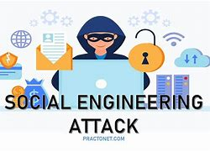
What is social engineering?
Definition "Social engineering in cybersecurity refers to the psychological manipulation of individuals to gain confidential information or access to systems."
Many different kinds
Most Common Methods phishing emails, pretexting, and baiting,

Slide 4
Who is affected? Who is attacking?
The Attacker
The Target or Victim
The Organization
The Bystanders

Slide 5
Examples
Scam phone calls
  Late payments, winning a trip
  Victim's personal info, Bank, Website
"Pilot," You, season 1, episode 1, Netflix, 2018
  Report's a gas leak
  Joe gains entry into Beck's home
Shane Dawson SIM swap (18.7m on YouTube)
  Attackers convinced his phone carrier to send a new sim card
  Phone number, Texts, MFA, "Forgot Password" access

Slide 6
Step by Step of How it Works
Research
Establish
Exploit
Execute
Exit and Cover
Research the Target
  Collect information from social media, public records, corporate websites.
  Toolkits like Maltego can aid this.
Establish Trust
  Use a believable pretext: "IT from your company," "delivery person," etc.
Exploit Human Psychology
  Leverage urgency, fear, authority, or curiosity.
  Example: "Your account will be disabled unless you verify your credentials."
Execute the Attack
  Deliver payload (e.g., malicious link), gather sensitive info, or gain physical access.
Exit and Cover Tracks
  Often no malware is left behind; the target never suspects a thing.
Notes:
Script:
Hi everyone, I’m Dane Shuler, a junior majoring in Computer Science, and I’ll be walking you through how social engineering works and how to defend against it.
Social engineering is a psychological attack, the hacker doesn’t break in through a firewall, they manipulate people. The process usually follows five steps:
First is research. Attackers gather personal or organizational details using social media, company websites, or public records. This helps them craft believable stories.
Next, they establish trust. They may pretend to be IT support, HR, or even a CEO. This leads into step three, exploitation, where they use urgency or authority to pressure someone into clicking a link, giving up credentials, or letting them in physically. Once they get what they want, they exit quietly and often leave no trace, which makes social engineering so dangerous

Slide 7
How to prevent?
Security Awareness Training
  Teach employees to identify phishing, vishing, etc.
  Simulated attacks can improve resilience.
2. Zero Trust Policy
  Never trust, always verify—especially with internal requests.
  MFA and role-based access control (RBAC).
3. Verify Identities
  Confirm caller/email sender by independent means.
  Use out-of-band verification.
4. Limit Data Exposure
  Reduce oversharing on social media or company bios.
5. Physical Security
  Use keycards, camera surveillance, and visitor logs.
Notes:
Script:
Now let’s talk about prevention. The number one defense is security awareness training. Teaching employees what these attacks look like, and simulating them, makes a huge difference. Another critical piece is a zero trust mindset: always verify before you trust, especially with internal messages or phone calls. Pair this with technical tools like multi-factor authentication and email filtering to stop most attacks before they land. Lastly, don’t overshare online, attackers love when you post your job title, work schedule, or even birthday. That’s all valuable data for them.

Slide 8
Red Flags to Watch For
1.Urgency or Pressure to Act Quickly
  Example: “Your account will be disabled in 15 minutes unless you reset your password now!”
  Sense of time pressure reduces critical thinking.
  Often used in phishing and phone scams.
2. Requests for Sensitive Information
  Example: “Please confirm your SSN or payroll login so we can process your bonus.”
  No legitimate organization asks for passwords, SSNs, or banking info over email or unsolicited calls.
3. Unusual Sender or Domain
  Example: An email from “admin@amaz0n-support.com” instead of “@amazon.com”.
  Look out for spoofed or slightly misspelled domains.
  Hover over links before clicking.
4. Generic Greetings and Poor Grammar
  “Dear user,” or “Hello sir/madam,” combined with awkward phrasing.
  Legitimate communications typically address you by name and use proper formatting.
5. Too Good to Be True Offers
  Example: “You’ve won a $500 gift card — click here to claim!”
  Emotional appeal (greed or excitement) is a common bait.
6. Unexpected Attachments or Links
  Don’t open attachments you weren’t expecting, especially from unknown senders.
Notes:
Script:
Here are some key red flags to remember: Urgency or fear, if a message says “act now or lose access,” slow down and double-check. Strange senders or links, hover over the email address and link before clicking. Requests for sensitive information like passwords or banking details should always raise suspicion. And finally, generic greetings or messages with poor grammar are often a giveaway. Being aware of these signs and pausing to verify can prevent major security breaches. Thanks for listening and remember, sometimes the biggest vulnerability isn’t a system, it’s us.

Slide 9

Future Changes
Use of AI for Personalized Attacks
Automation at Scale
Manipulating Trust in AI Systems
Augmented Reality (AR) and Virtual Reality (VR)
Targeting Smart Devices and IoT

Slide 10
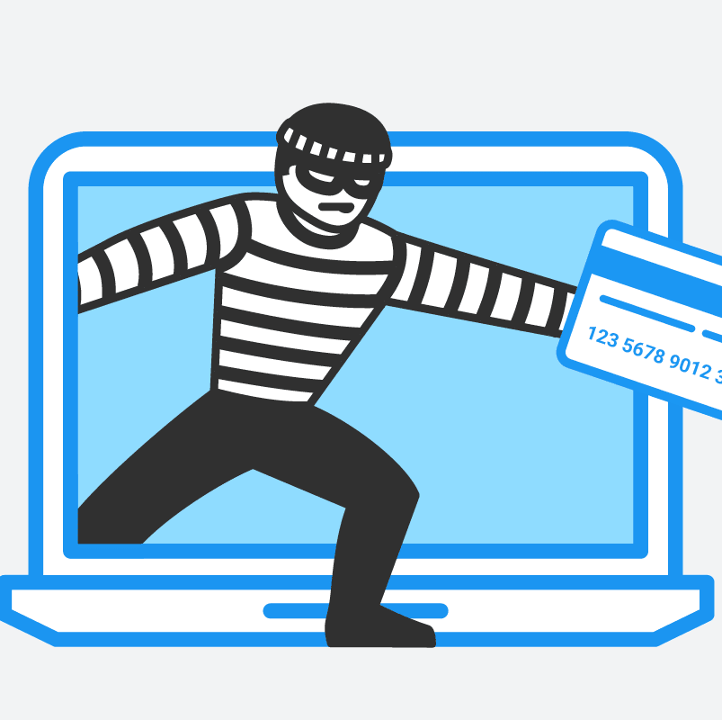
Social Engineering and IST 3333
Throughout the course of Information Science and Technology 3333, we have learned about Network and Information Security
Security isn't just technical; there is a large human element
Educating users and creating a security aware culture is essential

Slide 11

Conclusion
Social Engineering will be a challenge IT professionals continue to face
Good security plans include human behavior
Technology will evolve, but the psychology stays the same

Slide 12
References
Step by Step of How it Works: Mitnick, K. D., & Simon, W. L. (2011). The Art of Deception.
How to prevent: CISA. (2023). Avoiding Social Engineering and Phishing Attacks
Red Flags to Watch For: CISA (2023). Avoiding Social Engineering and Phishing and Hadnagy, C. (2018). Social Engineering: The Science of Human Hacking
Future changes:Red Edge(2023):The Future Of Social Engineering: Emerging Trends And Threats:

